Slide 1

HP Solve 2023
Final Submission
By
Name: Siddhant Dalvi
Email: siddhantdalvi9@gmail.com
College: Sinhgad Academy of Engineering (B.E | Computer Engineering )
LinkedIn: https://www.linkedin.com/in/siddhantdalvi/

Slide 2
Overview of Solution:
Data Crawling:
Identify relevant social media platforms where customers discuss HP printers, such as Twitter, Facebook, Reddit, or specialized forums. Implement a web crawler that searches for posts related to HP printers using specific keywords and hashtags. Retrieve the content of the posts, including text, timestamps, and user information.
2. Data Preprocessing:
Clean the retrieved data by removing irrelevant information like advertisements or unrelated posts. Extract key elements from the posts, such as the printer brand or model mentioned, features discussed, and sentiment indicators.

Slide 3
3. Post Classification and Tagging:
Develop a machine learning model to classify each post based on the printer brand or model mentioned. Extract and tag features or problems discussed in the posts using techniques like named entity recognition or keyword matching. Identify sentiment indicators in the posts, such as positive, negative, neutral, complaint, suggestion, or appreciation.
4. Knowledge Graph Construction:
Design a schema for the knowledge graph, including entities like posts, printers, features, sentiments, etc. Create nodes in the graph representing the entities extracted from the posts, with appropriate properties and relationships. Establish relationships between nodes to connect posts with printers, features, and sentiments, based on the extracted information.

Slide 4
5. Knowledge Graph Querying:
Develop a query interface that allows stakeholders to search and retrieve information from the knowledge graph. Implement query functionalities such as filtering posts based on printer models or brands, specific features, or sentiment categories. Provide options to retrieve aggregated statistics or trends based on customer sentiments, feature mentions, or printer models.

Slide 5
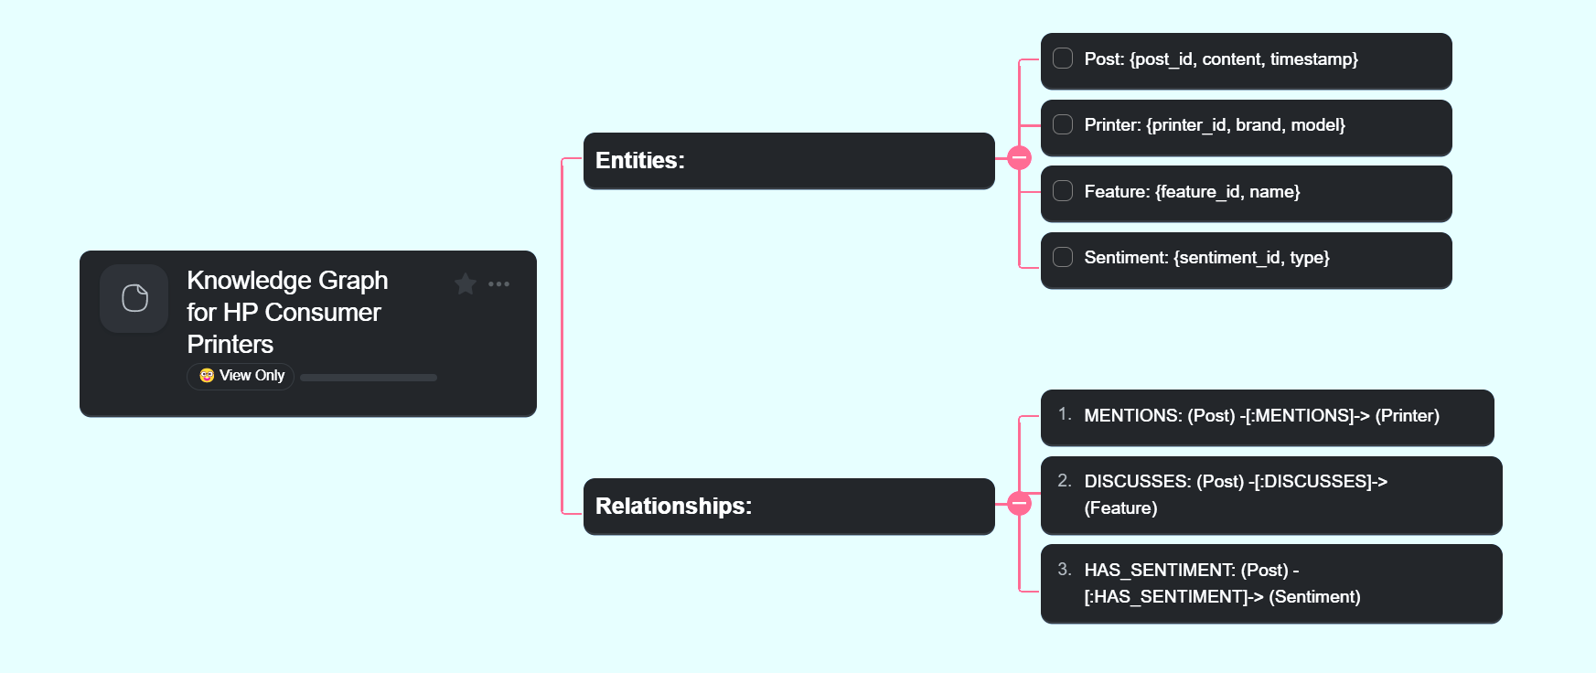
Knowledge Graph for HP Consumer Printers

Slide 6
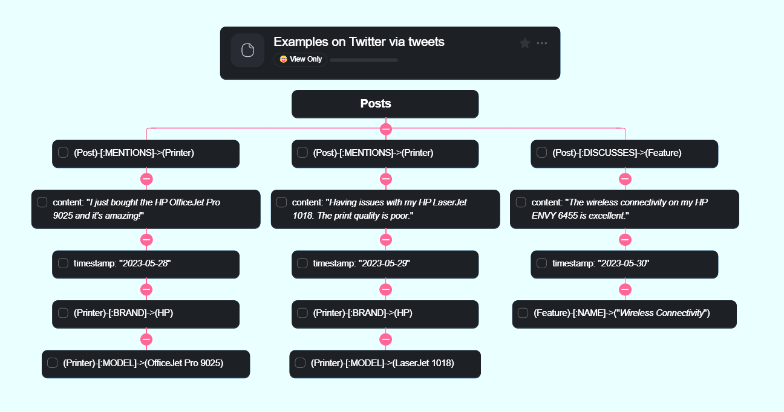
Examples on Twitter via tweets

Slide 7
Information about Libraries used
Library | Description
Social Media API | This library is used for accessing social media platforms and crawling posts. The specific library used is not mentioned in the code, but it could be a third-party library or a custom implementation tailored for the targeted social media platforms.
Text Classification Model | The code assumes the existence of a pretrained text classification model for classifying the brand, model, and sentiment of the posts. The specific model used is not mentioned in the code, but it could be a machine learning model such as a neural network-based model trained on labeled data.

Slide 8
Information about Libraries used (Continued)
Library | Description
Named Entity Recognition Model | The code assumes the availability of a pretrained named entity recognition model for extracting features and problems from the posts. The specific model used is not mentioned in the code, but it could be a machine learning model such as a sequence labeling model trained on annotated data.
Knowledge Graph Library | This library is used for constructing and querying the knowledge graph. The specific library used is not mentioned in the code, but it could be a graph database library or a custom implementation tailored for working with knowledge graphs.

Slide 9
Future Scope:
Here are some other ways to improve the code:
Use a more sophisticated sentiment analysis algorithm to improve the accuracy of the sentiment scores.
Use a natural language processing algorithm to identify the features of the tweets, such as the problem or feature that the tweet is talking about.
Use a machine learning algorithm to identify patterns in the data and to predict future trends.

Slide 10
Detailed code:
https://github.com/siddhant-dalvi/HP_Solve_2023/

Slide 11
Thank You

